Slide 1
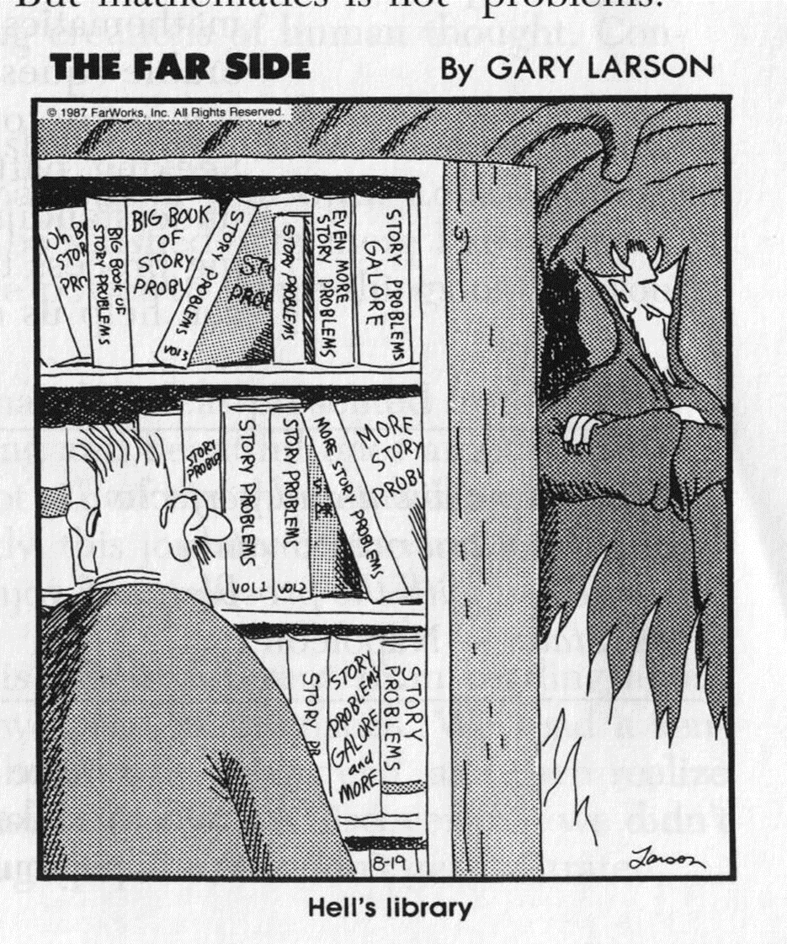
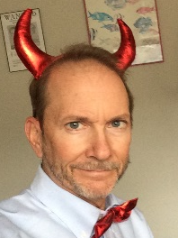
MSIS 5303 – Course Syllabus – Fall 2022
Rick Wilson

